Slide 1
Data Normalisation to Third Normal Form

Slide 2
Old Greenwich Hospital
Drug card
Patient Number | Surname | Forenames
923 | Moneybags | Maurice
Ward Number | Ward Name
10 | Barnard
Date | Drug Code | Drug Name | Dosage | Length of Treatment
20 May 2000 | CO2355P | Cortisone | 2 pills after meals | 14 days
20 May 2000 | MO3416T | Morphine | Injection every 4 hours | 5 days
25 May 2000 | MO3416T | Morphine | Injection every 8 hours | 3 days
26 May 2000 | PE8694N | Penicillin | 1 pill three times a day | 7 days
For additional drugs continue on another card …

Slide 3
Old Greenwich Hospital
Drug card
Patient Number | Surname | Forenames
109 | Foot | Ivor
Ward Number | Ward Name
11 | Fleming
Date | Drug Code | Drug Name | Dosage | Length of Treatment
15 May 2000 | AS473A | Aspirin | 2 pills three times a day after meals | 7 days
20 May 2000 | VA231M | Valium | 2 pills per day | 5 days
For additional drugs continue on another card …

Slide 4
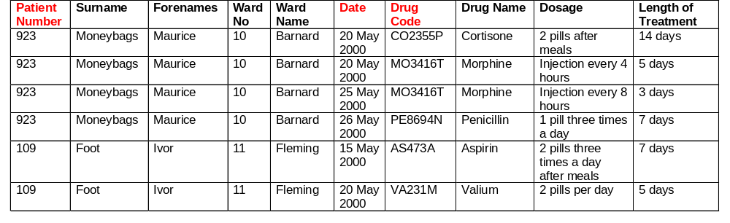
Stage 1
Represent the data as atomic items in a table in unnormalised form (UNF) and pick a primary key (denoted by #) that will uniquely identify an individual row in the table using the smallest possible combination of items.
#PatientNumber, Surname, Forenames, WardNo, WardName,
Repeated: (#Date, #DrugCode, DrugName, Dosage, LengthOfTreatment)

Slide 5
Stage 2
Represent the data in First Normal Form (1NF) by removing any repeating groups of data items to separate relations. (A repeating group is any data item or group of data items that may occur with multiple values for a single value of the primary key data item.) Pick keys for the relations identified.
Patient Number | Surname | Forenames | Ward No | Ward Name
923 | Moneybags | Maurice | 10 | Barnard
109 | Foot | Ivor | 11 | Fleming
Patient Number | Date | Drug Code | Drug Name | Dosage | Length of Treatment
923 | 20 May 2000 | CO2355P | Cortisone | 2 pills after meals | 14 days
923 | 20 May 2000 | MO3416T | Morphine | Injection every 4 hours | 5 days
923 | 25 May 2000 | MO3416T | Morphine | Injection every 8 hours | 3 days
923 | 26 May 2000 | PE8694N | Penicillin | 1 pill three times a day | 7 days
109 | 15 May 2000 | AS473A | Aspirin | 2 pills three times a day after meals | 7 days
109 | 20 May 2000 | VA231M | Valium | 2 pills per day | 5 days
#PatientNumber #Date #DrugCode DrugName Dosage LengthOfTreatment | #PatientNumber Surname Forenames WardNo WardName

Slide 6
Stage 3
Represent the data in Second Normal Form (2NF) by removing any data items that only depend on part of the key to separate relations. This only affects tables that have composite keys.
Patient Number | Date | Drug Code | Dosage | Length of Treatment
923 | 20 May 2000 | CO2355P | 2 pills after meals | 14 days
923 | 20 May 2000 | MO3416T | Injection every 4 hours | 5 days
923 | 25 May 2000 | MO3416T | Injection every 8 hours | 3 days
923 | 26 May 2000 | PE8694N | 1 pill three times a day | 7 days
109 | 15 May 2000 | AS473A | 2 pills three times a day after meals | 7 days
109 | 20 May 2000 | VA231M | 2 pills per day | 5 days
Drug Code | Drug Name
CO2355P | Cortisone
MO3416T | Morphine
PE8694N | Penicillin
AS473A | Aspirin
VA231M | Valium
Patient Number | Surname | Forenames | Ward No | Ward Name
923 | Moneybags | Maurice | 10 | Barnard
109 | Foot | Ivor | 11 | Fleming
#PatientNumber #Date #DrugCode Dosage LengthOfTreatment | #DrugCode DrugName | #PatientNumber Surname Forenames WardNo WardName

Slide 7
Stage 4
Represent the data in Third Normal Form (3NF) by removing any data items not directly dependent on the key to separate relations. If the data item in a relation is a primary key in another relation then it is called a foreign key (denoted by a *).
Drug Code | Drug Name
CO2355P | Cortisone
MO3416T | Morphine
PE8694N | Penicillin
AS473A | Aspirin
VA231M | Valium
Patient Number | Surname | Forenames | Ward No
923 | Moneybags | Maurice | 10
109 | Foot | Ivor | 11
Red: PK
Blue: FK
Ward No | Ward Name
10 | Barnard
11 | Fleming
Patient Number | Date | Drug Code | Dosage | Length of Treatment
923 | 20 May 2000 | CO2355P | 2 pills after meals | 14 days
923 | 20 May 2000 | MO3416T | Injection every 4 hours | 5 days
923 | 25 May 2000 | MO3416T | Injection every 8 hours | 3 days
923 | 26 May 2000 | PE8694N | 1 pill three times a day | 7 days
109 | 15 May 2000 | AS473A | 2 pills three times a day after meals | 7 days
109 | 20 May 2000 | VA231M | 2 pills per day | 5 days
TREATMENT | DRUG | WARD | PATIENT
#PatientNumber #Date #DrugCode Dosage LengthOfTreatment | #DrugCode DrugName | #WardNo WardName | #PatientNumber Surname Forenames *WardNo

Slide 8
Stage 5
The results from the previous stages need to be merged by joining together any relations which have the same key. Check the resulting relations are in third normal form.
Patient Number | Surname | Forenames | Ward No
923 | Moneybags | Maurice | 10
109 | Foot | Ivor | 11
Patient Number | Date | Drug Code | Dosage | Length of Treatment
923 | 20 May 2000 | CO2355P | 2 pills after meals | 14 days
923 | 20 May 2000 | MO3416T | Injection every 4 hours | 5 days
923 | 25 May 2000 | MO3416T | Injection every 8 hours | 3 days
923 | 26 May 2000 | PE8694N | 1 pill three times a day | 7 days
109 | 15 May 2000 | AS473A | 2 pills three times a day after meals | 7 days
109 | 20 May 2000 | VA231M | 2 pills per day | 5 days
Drug Code | Drug Name
CO2355P | Cortisone
MO3416T | Morphine
PE8694N | Penicillin
AS473A | Aspirin
VA231M | Valium
Ward No | Ward Name
10 | Barnard
11 | Fleming

Slide 9
Stage 5 (Continued)
Third Normal Form Test 1
Given a value for the key(s) of a 3NF relation, is there just one possible value for each data item in that relation?
Third Normal Form Test 2
Is each data item in a 3NF relation directly and wholly dependent on the key(s) of that relation?
UNF (1 table) | 1NF (2 tables) | 2NF (3 tables) | 3NF (4 tables)
#PatientNumber #Date #DrugCode Surname Forenames WardNo WardName DrugNameDosage LengthOfTreatment | #PatientNumber Surname Forenames WardNo WardName #PatientNumber #Date #DrugCode DrugName Dosage LengthOfTreatment | #PatientNumber Surname Forenames WardNo WardName #PatientNumber #Date #DrugCode Dosage LengthOfTreatment #DrugCode DrugName | #PatientNumber Surname Forenames *WardNo #WardNo WardName #DrugCode DrugName #PatientNumber #Date #DrugCode Dosage LengthOfTreatment
#: PK
*: FK

Slide 10
DATA NORMALISATION TO THIRD NORMAL FORM SUMMARY
“I swear to be dependent on the key, the whole key and nothing but the key, so help me Codd”

